Slide 1
Chapter 14b:
Frameworks

Slide 2
Objectives
To understanding the meaning and usage of frameworks
To understand the framework development process

Slide 3
Frameworks
A framework is a collection of software artifacts that is usable by several different applications
Classes within a framework may be related and applications may use them by means of inheritance, aggregation or dependency.
E.g.
  Java API’s (3D, 2D, Swing)
  The Enterprise Java Bean (EJB)
  Microsoft MFC

Slide 4
Framework Definitions
A framework is a set of cooperating classes that comprise a reusable backbone for a specific application domain.
  A framework provides an integrated set of domain- specific functionality
A framework is a semi-complete application
  A framework is customized to a particular application by deriving application specific classes from abstract classes defined by the framework.

Slide 5
Framework Definitions (Cont’d)
According to Erich Gamma a Framework can be defined as :
  A set of cooperating classes that makes up a reusable design for a specific class of software. A framework provides architectural guidance by partitioning the design into abstract classes and defining their responsibilities and collaborations. A developer customizes the framework to a particular application by subclassing and composing instances of framework classes.
This means a framework is a predefined architecture for a business domain, consisting of both ready-to-use and semi-finished building blocks.

Slide 6
Why Frameworks
Modularity
  Frameworks enhance modularity by encapsulating volatile implementation details behind stable interfaces.
  Framework modularity helps improve software quality by localizing the impact of design and implementation changes.
  This localization reduces the effort required to understand and maintain existing software.

Slide 7
Why Frameworks (Cont’d)
Reusability
  The stable interfaces provided by frameworks enhance reusability by defining generic components that can be reapplied to create new applications.
  Framework reusability leverages the domain knowledge and prior effort of experienced developers in order to avoid recreating and revalidating common solutions to recurring application requirements and software design challenges.
  Reuse of framework design components can yield substantial improvements in programmer productivity, as well as enhance the quality, performance, reliability, and interoperability of software.

Slide 8
Why Frameworks (Cont’d)
Extensibility
  A framework enhances extensibility by providing explicit “hook methods” that allow applications to extend its stable interfaces.
  These extension points systematically decouple the stable interfaces and behavior of the application domain from the variations required by instantiations of the application in a particular context.
  Framework extensibility is essential to ensure timely customization of new application services and features.

Slide 9
Framework Challenges
Developing high quality reusable extensible frameworks for application domains involves complicated tasks.
It takes a substantial amount of time and effort to learn how to utilize OO application frameworks.
Requirements of frameworks often change with changing application requirements.
Frameworks need maintenance including both adaptation and modification.
No current common standards exist for the design, implementation, documentation, and adaptation of frameworks.

Slide 10
Frameworks vs. Components
Frameworks have lots of room for customization and they have interfaces that are more complex than those of many other components.
Frameworks and other software components are different but cooperating technologies.
  Frameworks are built from building blocks, which are their component classes.
  At the same time, frameworks themselves are application building blocks and are used to build larger systems.

Slide 11
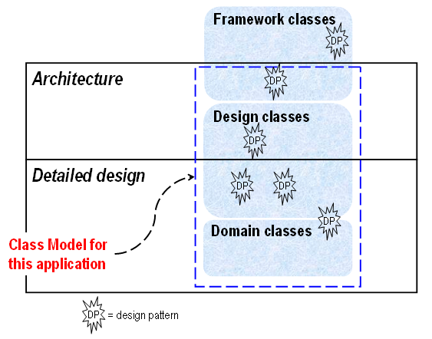
Class Model vs. Architecture and Detailed Design

Slide 12
Framework Development Process
Domain Analysis
Architectural Design
Framework Design
Framework Implementation
Framework Testing
Documentation

Slide 13
Principles of Framework Design
First rule:
  Don't design, buy one, instead.
Designing reusable code requires iteration
  Reusable code requires many iterations.
  Basic law of software engineering: “if it hasn't been tested, it doesn't work”, thus software that hasn't been reused is not reusable.
Frameworks encode domain knowledge
  Frameworks solve a particular set of problems.
  Not always application-domain specific
Customer of framework is application programmer
Frameworks are abstractions: people generalize from concrete examples

Slide 14
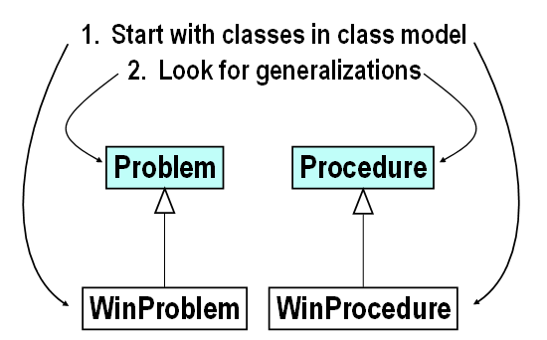
Seeking Generalization: Bottom-up

Slide 15
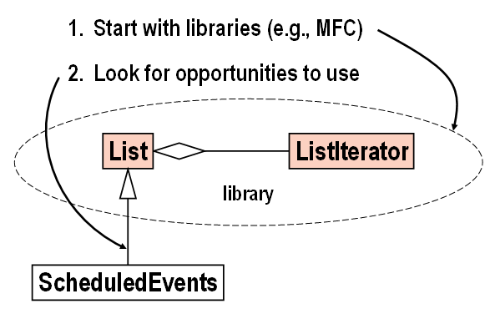
Seeking Generalization: Top-down

Slide 16
Ideal Way to Develop Framework
Analyze problem domain
  Learn well-known abstractions.
  Collect examples of programs to be built from framework. (Minimum of 4 or 5).
Design abstraction that covers examples.
Test framework by using it to solve the examples.
  Each example is a separate application.
  Performing a test means writing software.

Slide 17
Why Ideal is Never Followed
Analyzing domain requires analyzing individual examples, which is very hard.
  Only practical if examples have already been analyzed.
  Analyzing and implementing examples is large fraction of the cost of the project.
Old applications work, so there is no incentive to convert them to use framework.

Slide 18
Good Way to Develop Framework
Pick two similar applications.
Include developers experienced in the same domain.
One framework group
  Consider other applications
  Explain and teach framework
Two application groups
  Try to reuse as much software as possible
  Complain about how hard software is to use

Slide 19
Typical Way to Develop Framework
Notice that many applications are similar.
Develop next application in that domain in an OO language.
Divide software into reusable and non-reusable parts.
Develop next application reusing as much software as possible.
If framework is not very reusable
Fix it
Develop next application reusing as much software as possible.

Slide 20
Another Strategy
Design framework - prototype several small applications
Build real application
Refactor and extend framework and old applications

Slide 21
Summary of Process
Start with examples of desired applications
Iteratively develop abstractions
Test by building applications

Slide 22
Summary
A framework: a collection of classes applicable to multiple applications
Framework development process:
  Domain Analysis
  Architectural Design
  Framework Design
  Framework Implementation
  Framework Testing
  Documentation
Notes:
Acknowledgment: the clip art in these notes are due to Microsoft and Corel Inc.
7.5 Conclusion & Exercises

